Slide 1
The Battle of Neighborhoods
Differences and Similarities Across US Cities
Alanne Park | 03-25-19

Slide 2
Introduction
As more and more people live in cities, it is also expected to see a growing number of restaurants, shops, parks, clubs, etc. – as these venues are considered indispensable in most urban areas. With that, we also expect a certain level of variation and diversity among venue types in each city, and even in each neighborhood, which is largely influenced by the interests and preferences of its community.
Project’s Background

Slide 3
The problem
This project aims to find similarities of neighborhoods across seven US cities based on information about their venues.
Knowledge on the distribution of such venues allows:
Travelers
Home Buyers
Businesses
Tourists to visit regions with a higher concentration of historic/famous sites.
New families to buy homes closer to recreation centers and schools.
Entrepreneurs to find the best area to bring or open new company sites.

Slide 4
Data
Description
Source
Usage
Selected Information
List of neighborhoods, their geolocations, the types of venues in each location, and frequency of each venue type.
Where They Came From
Governmental pages, Google Maps, GitHub, GeoJSON.io, and the Foursquare API.
How They Contribute
Create maps and markers with Folium, frequency and cluster tables with Python, graphs on JMP.

Slide 5
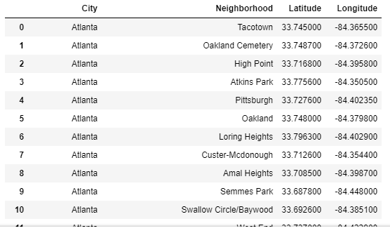
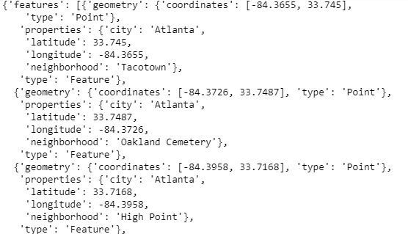
GeoJSON to Pandas Dataframe

Slide 6
Methodology

Slide 7
Import and Analyze Data
Find Venues with Foursquare
Cluster Neighborhoods
1st
2nd
3rd
4th
5th
6th
Map Cities and Neighborhoods
Analyze Each Neighborhood
Examine Each Cluster

Slide 8
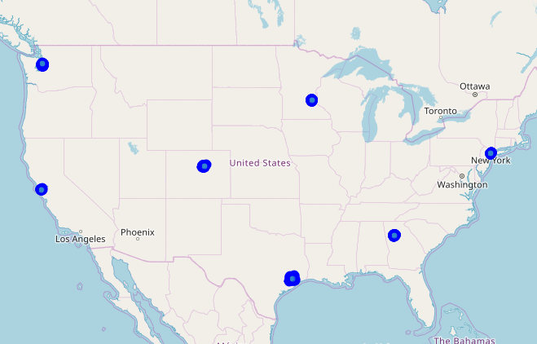
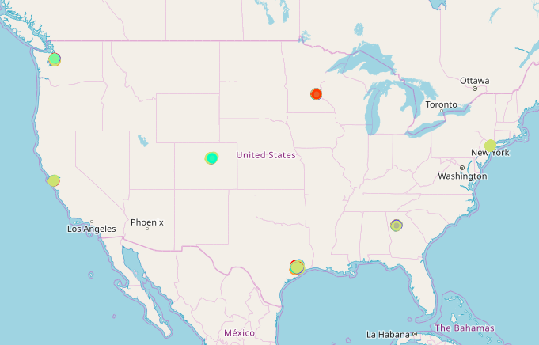
Maps with Folium - 7 Cities

Slide 9
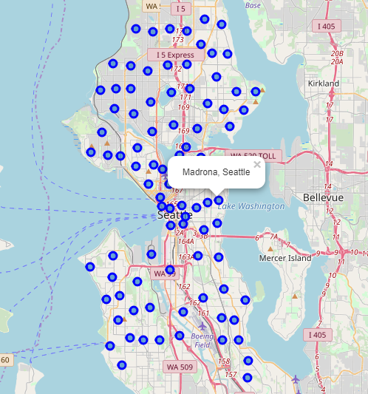
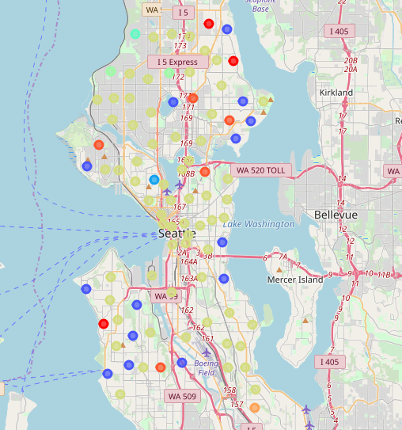
Maps with Folium - Seattle

Slide 10
Results

Slide 11
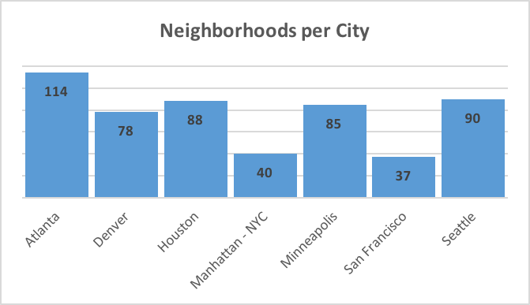
Representation
Neighborhoods per City

Slide 12
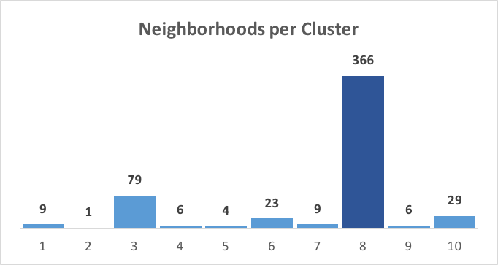
Typical
Most Common Cluster

Slide 13
Categories
Cluster | Venue | Frequency
1 | Gym | 22%
 | Pool | 22%
2 | Ramen Restaurant | 100%
3 | Park | 29%
4 | Playground | 83%
5 | Trail | 100%
6 | Trail | 61%
7 | Park | 100%
8 | Coffee Shop | 11%
9 | Construction & Landscaping | 67%
10 | Grocery Store | 17%
 | Coffee Shop | 17%
Most Common Venues per Cluster

Slide 14
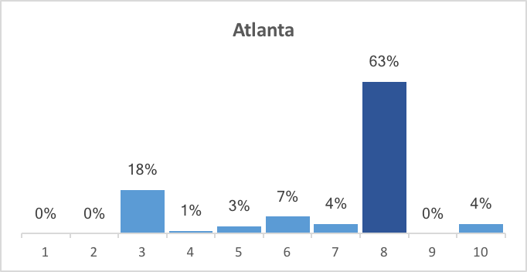
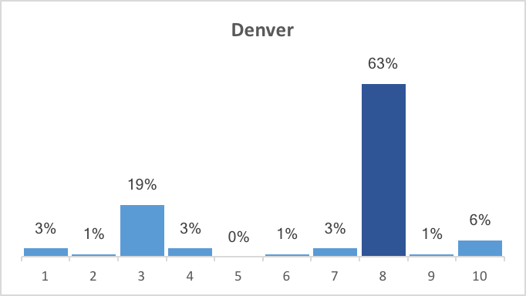
Distribution
Most Common Clusters per City

Slide 15
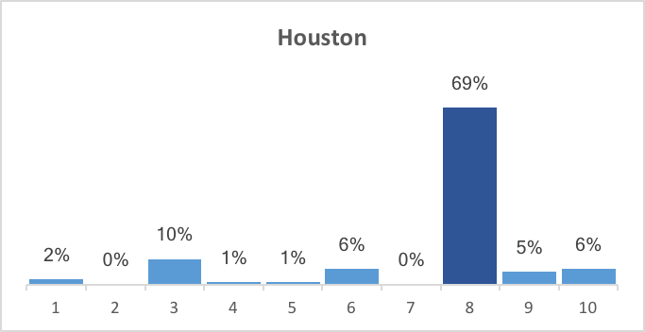
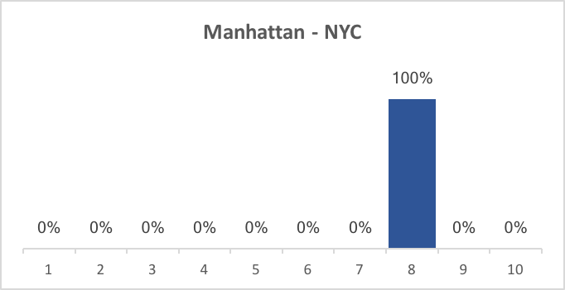
Distribution - Cont.
Most Common Clusters per City

Slide 16
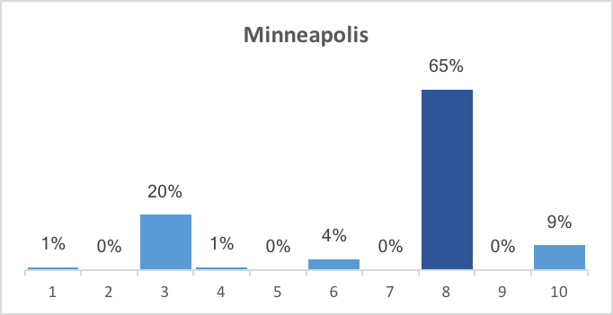
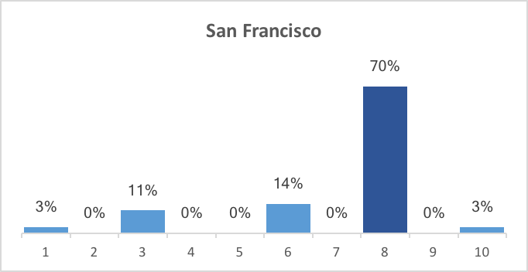
Distribution - Cont.
Most Common Clusters per City

Slide 17
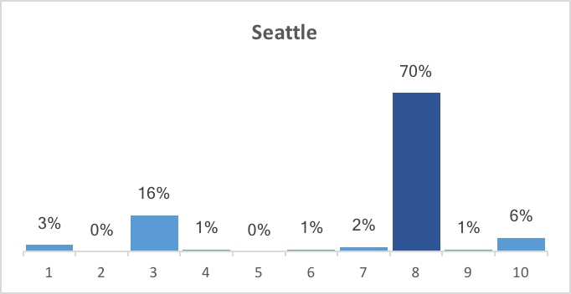
Distribution - Cont.
Most Common Clusters per City

Slide 18
Diversity
City | Clusters | Count
Atlanta | 3, 4, 5, 6, 7, 8, 10 | 7
Denver | 1, 2, 3, 4, 6, 7, 8, 9, 10 | 9
Houston | 1, 3, 4, 5, 6, 8, 9, 10 | 8
Manhattan - NYC | 8 | 1
Minneapolis | 1, 3, 4, 6, 8, 10 | 6
San Francisco | 1, 3, 6, 8, 10 | 5
Seattle | 1, 3, 4, 6, 7, 8, 9, 10 | 8
Number of Clusters per City

Slide 19
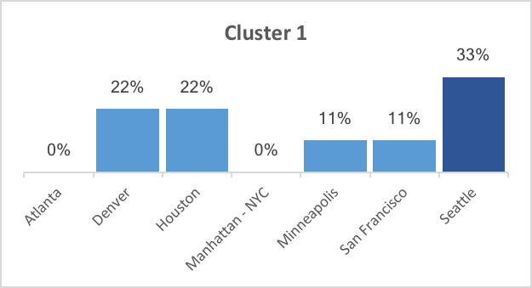
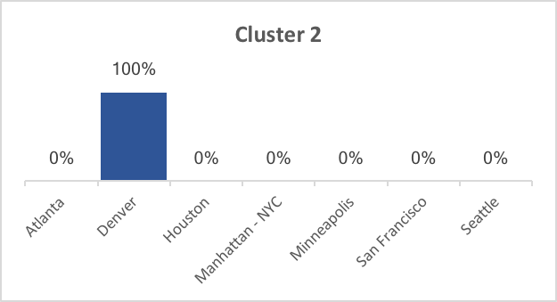
Leaders
Most Common Cities per Cluster

Slide 20
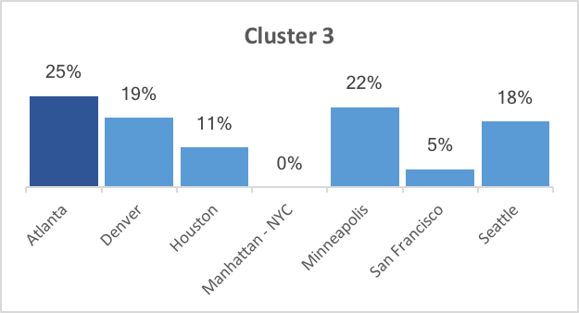
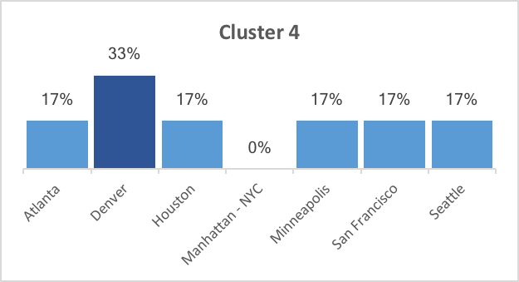
Leaders - Cont.
Most Common Cities per Cluster

Slide 21
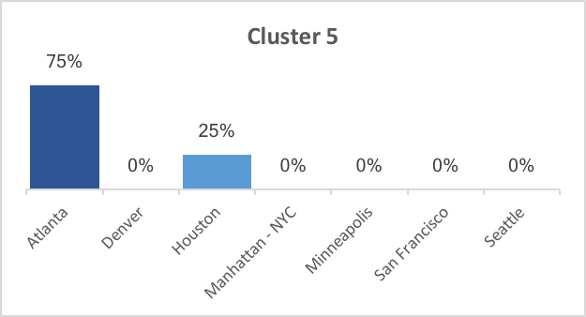
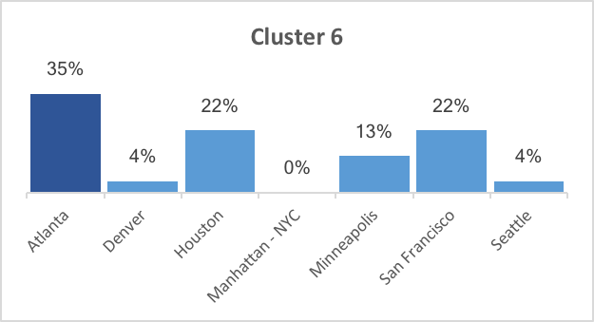
Leaders - Cont.
Most Common Cities per Cluster

Slide 22
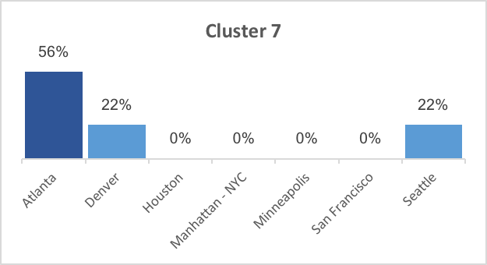
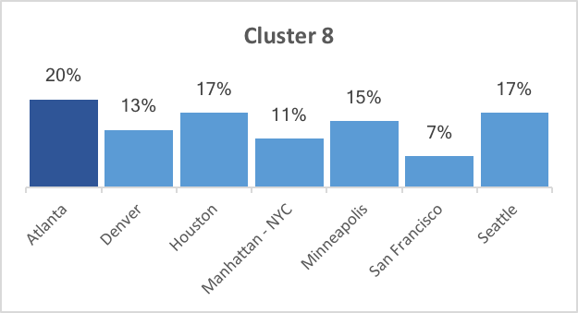
Leaders - Cont.
Most Common Cities per Cluster

Slide 23
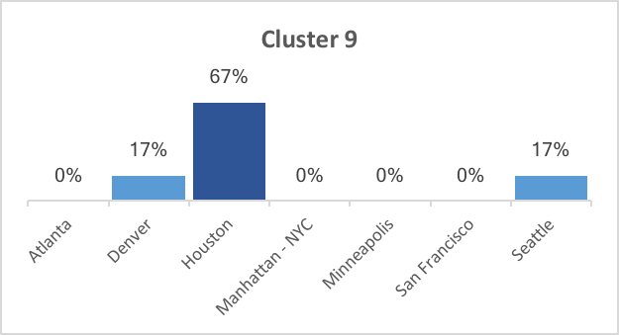
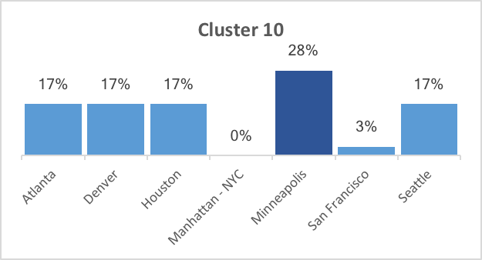
Leaders - Cont.
Most Common Cities per Cluster

Slide 24
Popular
City | Venue | Frequency
Atlanta | Park | 15%
 | Trail | 8%
Denver | Park | 13%
 | Pizza Place | 5%
Houston | Burger Joint | 6%
 | Fast Food Restaurant, Hotel, Mexican Restaurant | 5%
Manhattan - NYC | Italian Restaurant | 28%
 | Coffee Shop | 23%
Minneapolis | Coffee Shop | 12%
 | Park | 8%
San Francisco | Park | 22%
 | Coffee Shop, Trail | 11%
Seattle | Coffee Shop | 18%
 | Park, Bus Stop | 6%
Most Common Venues

Slide 25
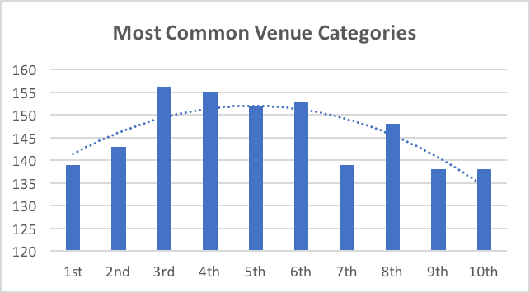
Popular - Cont.
Most Common Venues

Slide 26
Discussion

Slide 27
Observations
With the analysis above, we can make assumptions on how diverse cities are when compare to each other, how neighborhoods are similar overall, and what kind of venues are more common in each neighborhood and city.

Slide 28
Recommendations
According to the above observations and the overall analysis on part 4, active families and individuals might prefer moving to Atlanta, Denver or San Francisco, as these areas have more outdoor space than the others. Those who love eating out might – especially American fast food – would prefer Houston, while Manhattan - NYC and Seattle seem to be a good fit for those with fast-paced lives and who like a more urban environment.

Slide 29
Recommendations
Cont.
Although tourists might enjoy visiting all cities, they might have better expectations on what they will find in each of them, and in which neighborhoods might find their preferred experiences. Similarly, different companies might find advantages in various locations. Still, we could infer that businesses focused on the different groups mentioned above would be more successful in the cities and neighborhoods they are most likely located.

Slide 30
Conclusion

Slide 31
Overall
Venue type and presence is a significant factor when grouping and comparing locations, and Foursquare API is a useful tool for the task. It is also clear that, although cities seem to have similar “most common venues”, there is not a singular or unique way in which those places are distributed in urban areas. Nonetheless, it is important to consider not only the first or second most common venue types, but to actually look into at least the top ten most frequent in order to have a good idea of a neighborhood’s identity.

Slide 32
Future
Directions
Although this study introduces a good start for the comparison of neighborhoods and cities, to effectively find and recommend the best locations for specific clients, it would be necessary to add important variables to the analysis – such as population numbers, real estate prices, crime rates, weather, and cultural characteristics – depending on the desired goal.

Slide 33
Thank You!

